Slide 1

Churn Diagnosis & Retention Strategy for Telecommunications Services
A data driven analysis of why customers leave and how to prevent It.
Present by: Syed Turab Ali Zaidi

Slide 2

Agenda
Dataset overview
Problem statement
Why this matter
Exploratory data analysis
Sentimental analysis
Clustering technique
Churn prediction
Retention Strategy

Slide 3
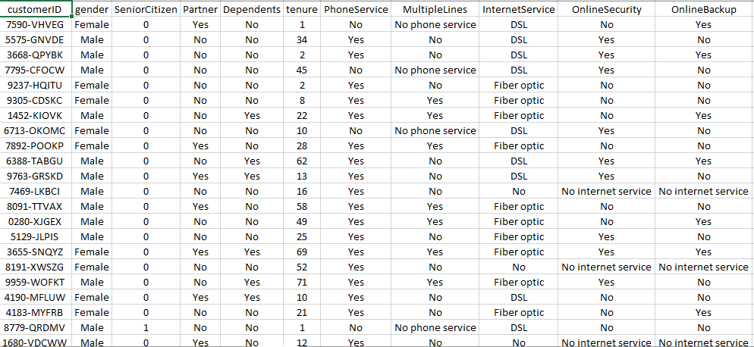
1. Understanding the Customer Dataset
Dataset Overview
Source: Telco Customer Churn (Kaggle)
7,043 customers
Total 21 features
Outcome: Churn (Yes/No)
Key Variables
Customer Profile: Gender, senior citizen, dependents
Service Details: Subscription of phone, online security, streaming, and internet type such as flash fiber, DSL.
Account Details: Tenure, contract type, billing method, charges

Slide 4



2. The Churn Problem
A significant portion of customers are leaving early in their journey, often due to unmet expectations, high charges, and poor service experience.
Churn Ratio
Over one-quarter of customers are leaving.
Loss of High-Value Customers
This impacts long-term revenue and profitability.

Slide 5




3. Why Churn Matters
Understanding why customers leave enables the company to protect revenue, strengthen loyalty, and focus retention efforts on the customers who matter most.
Reduced Revenue
Weakened Loyalty
Impacted Profitability

Slide 6
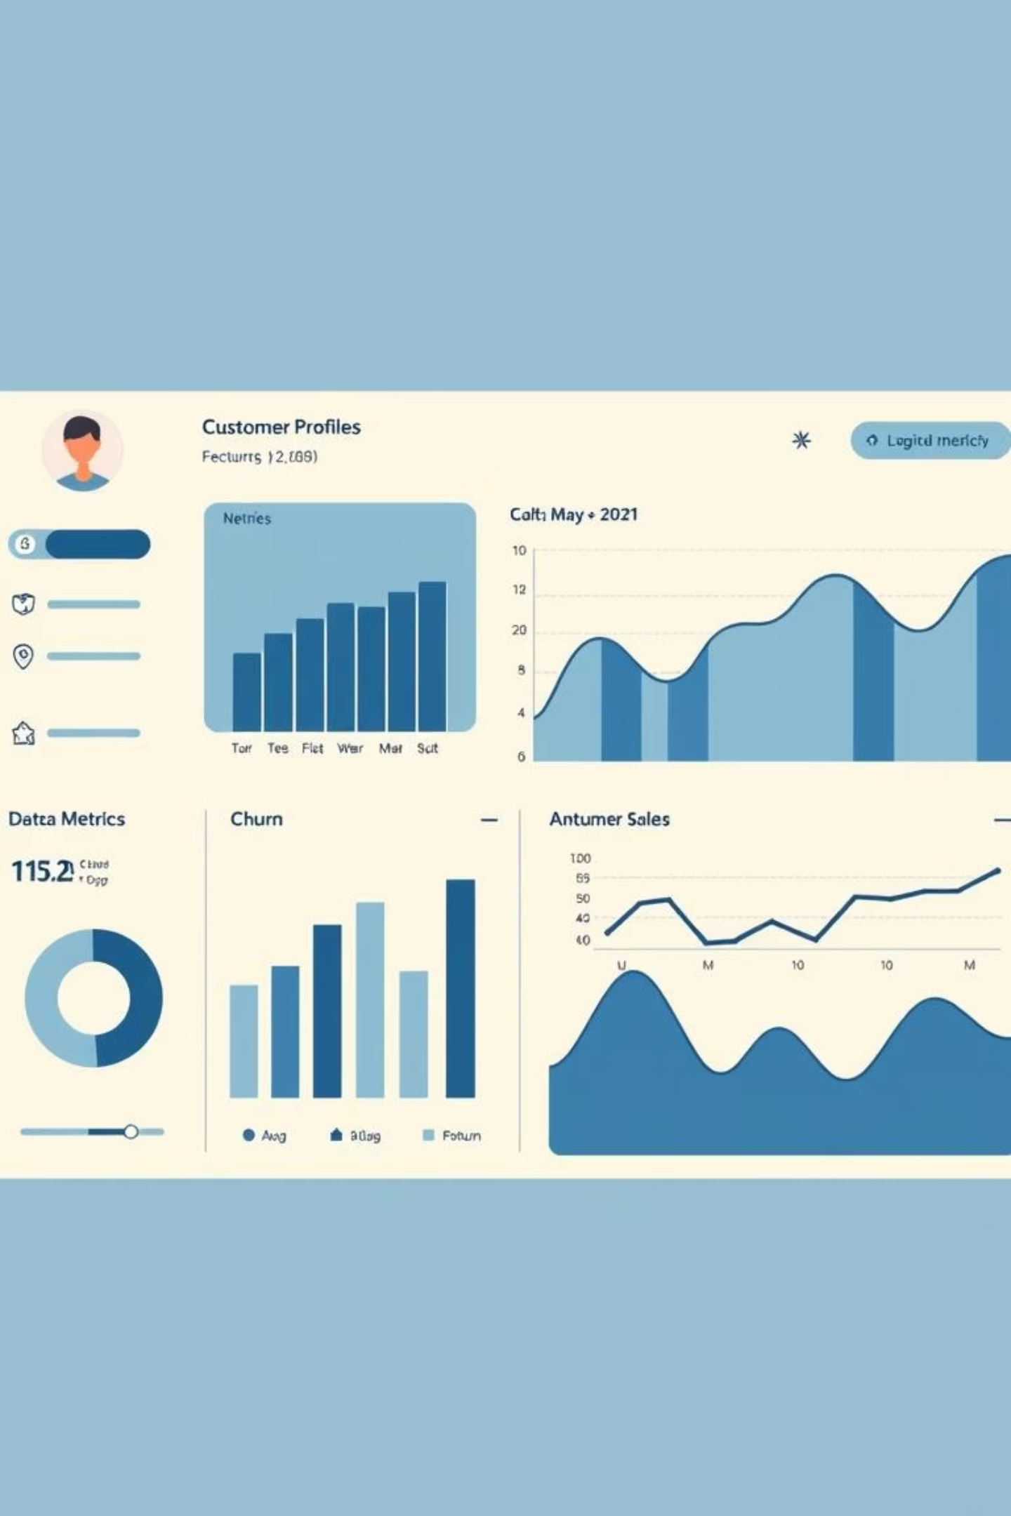
4. Exploratory Data Analysis
Uncovering Patterns
Identifying Risk Factors
Visualizing Trends

Slide 7
The Scale of Loss
The company is losing 1 in 4 customers, leading to substantial financial impact.
26%
1869
Overall Churn
Lost Customers
A significant portion of our customer base.
Total number of customers who have churned.

Slide 8
Pricing Pressure
Churners pay significantly more
High-cost and month-to-month is the biggest vulnerable group.

Slide 9

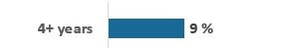

Early Life Exit
Nearly 1 in 2 customers churn within the first year of service.

Slide 10
Payment Friction
Manual billing creates friction, leading to customer drop-off.
Electronic check: 58% churn
Auto-pay: 12% churn

Slide 11
Missing Services Drive Churn
When customers feel unprotected and unsupported, they leave.

Slide 12
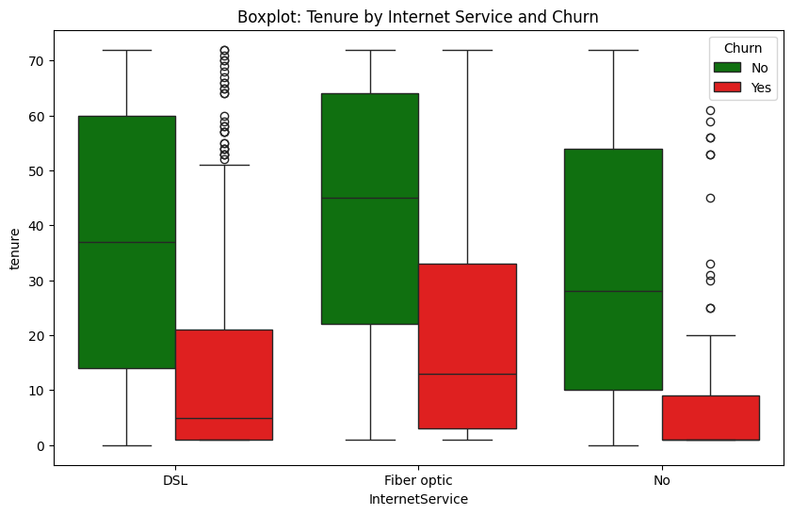
Tenure vs Internet Service
Churn is an early-life problem, not a loyalty problem.
Fiber optic customers churn earlier than DSL customers, indicating unmet expectations.
No-internet customers show the shortest tenure, suggesting weak engagement.
Phone services with No Internet

Slide 13

05. Sentimental Analysis

Slide 14
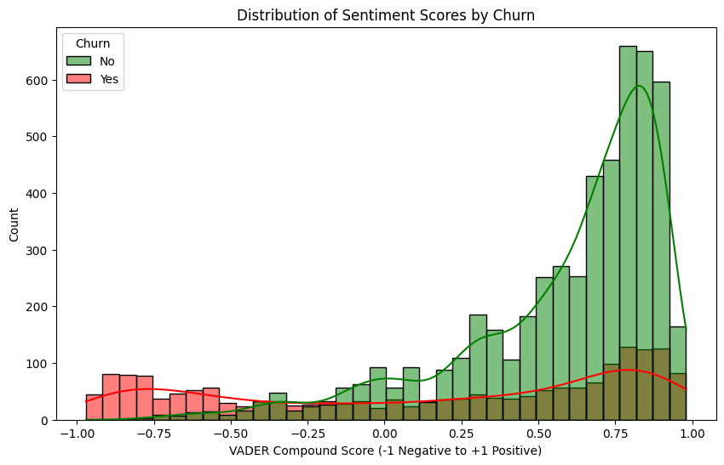
Overall sentiment polarity and intensity
VADER (Valence Aware Dictionary and Sentiment Reasoner) model
Customers don’t churn suddenly their sentiment turns negative first.
Green bars peak around +0.6 to +0.9. Most retained customers are satisfied
Red bars are concentrated between -1.0 and -0.3. Strong dissatisfaction appears before churn
Sentiment analysis enables proactive retention before cancellation

Slide 15
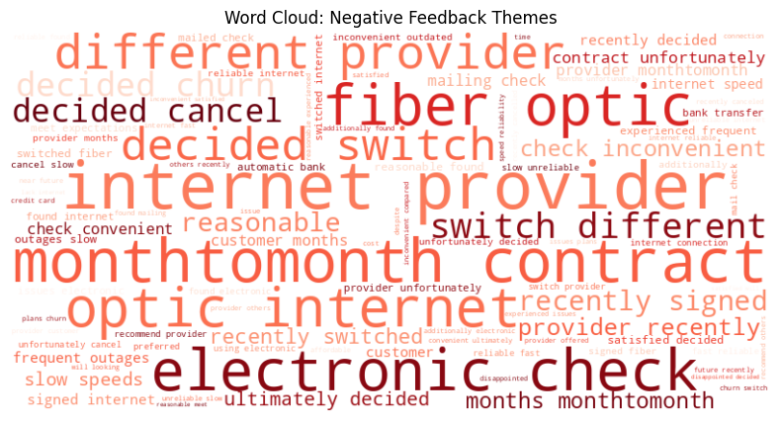
Key Drivers from Negative Customer Feedback
Customers churn mainly due to following issues
Internet quality issues
High monthly charges
Billing/payment frustration
Month-to-month contracts

Slide 16
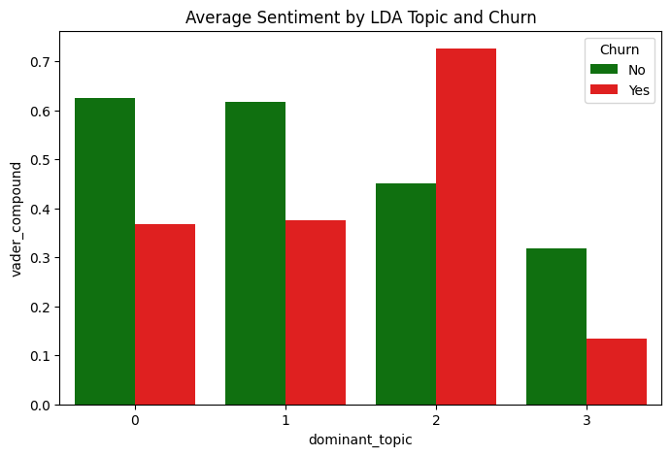
LDA Topics and Sentiment Analysis
Combining topic modeling and sentiment provides deeper churn insights than sentiment alone
Topic | Keywords | Interpretation | Churn Risk
0 | payment, automatic, monthly charges | Billing & autopay experience | Medium
1 | month, check, charge | Month-to-month, price-sensitive | High
2 | fiber, quality, reliable, fast | Fast fiber, happy customers | Very Low
3 | provider, decided, recently | Thinking about switching | Very High

Slide 17

06. Clustering Technique

Slide 18
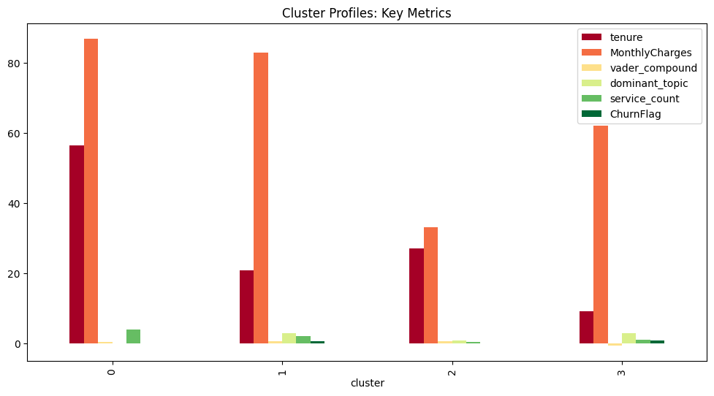
K-Means Clustering
Enables precise targeting
Cluster | Tenure (months) | Monthly Charges | Sentiment Score | Dominant topic | Churn Flag
0 | 56 | 86$ | 0.57 | 0.0 | 5%
1 | 20 | 82$ | 0.62 | 3.0 | 60%
2 | 27 | 33$ | 0.65 | 1.0 | 1%
3 | 9 | 62$ | -0.53 | 3.0 | 86%

Slide 19
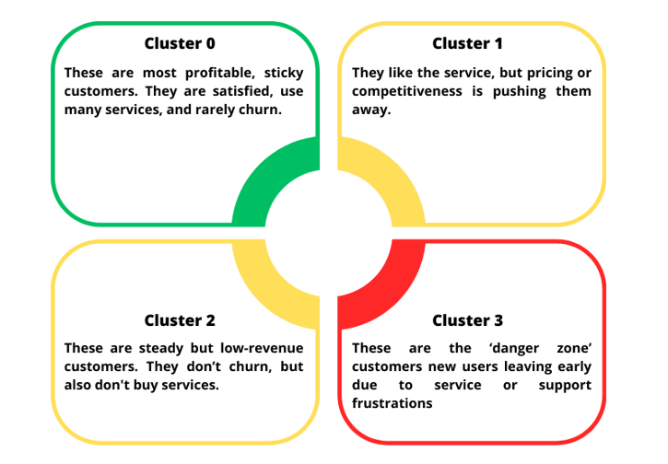
Insights

Slide 20
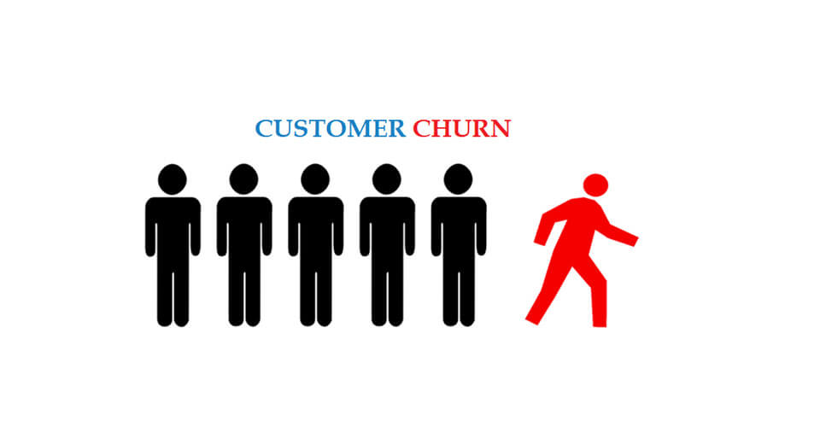
07. Churn Prediction
Turning Prediction into Prevention

Slide 21
Model Selection
A comparative analysis of the four selected classification models reveals their performance across key evaluation metrics, with a particular focus on the F1-Score.
Model | Accuracy | ROC-AUC | Churn Recall | Churn precision | Churn F1
Logistic | 84% | 0.91 | 76% | 67% | 0.71
Random Forest | 85% | 0.91 | 76% | 69% | 0.73
XGBoost | 88% | 0.93 | 76% | 77% | 0.77
Neural Network | 86% | 0.85 | 78% | 78% | 0.69
Stacking | 87% | 0.92 | 73% | 73% | 0.75
From Insights to prediction XGBoost model is the best performer

Slide 22
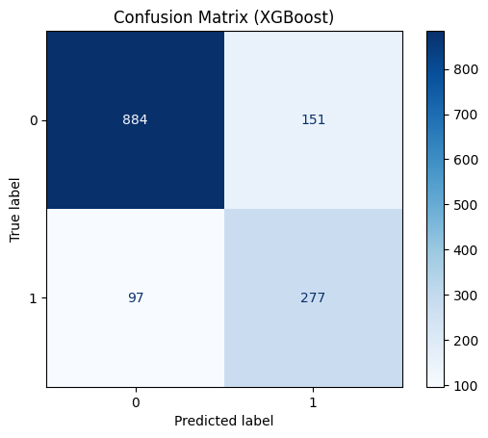
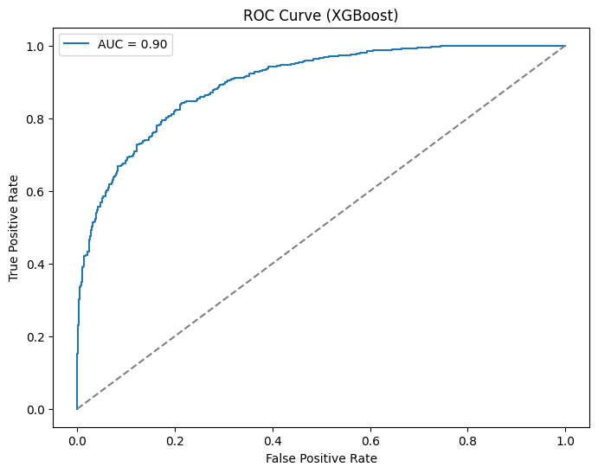
Model Prediction Quality
The model accurately identifies most churners while maintaining a manageable false alarm rate, making it suitable for proactive retention targeting.
With an AUC of 90%, the model demonstrates strong ability to distinguish high-risk churn customers from loyal ones.

Slide 23
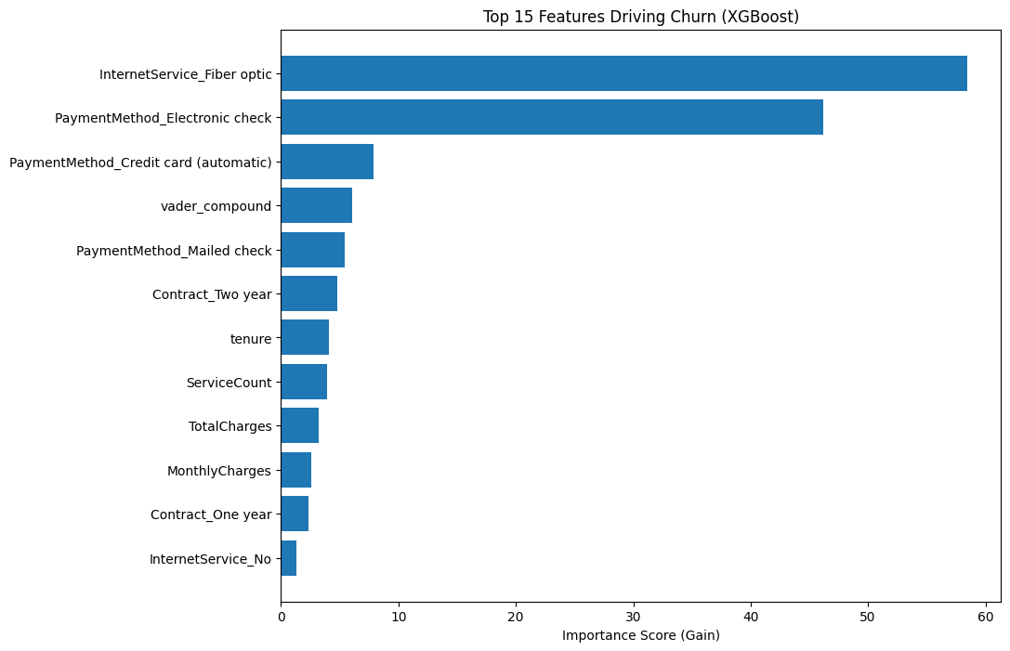
What Actually Drives Churn
Churn is driven by service type, payment friction, customer sentiment, and early-stage tenure

Slide 24





08. Retention Strategy
First 90-Day Program
Proactive check-ins, free add-on trials, speed reassurance.
Contract Upgrades
Incentivize 1-year upgrades, bundle high-value add-ons.
Reduce Billing Friction
Incentivize auto-pay (5-10% discount), move from electronic checks.
Target Fiber Customers
Priority support, network monitoring, speed guarantee.
Intelligent Pricing
Personalized retention discounts for high-charge/high-churn customers.

Slide 25
Thank You
Any Questions

